Slide 1

Design of a Remote-Controlled Racing Car Using a Wireless Audio Link

Slide 2





A Little About Me
Education
Pursuing a Bachelor of Science degree in Electrical and Information Engineering
IEB National Senior Certificate
Work Experience
Lab Technician
Data Science and Data Engineering
Tutor
Hobbies
Martial Arts
DIY Projects
Gamming and PC Enthusiast
Fun Fact
I hold the award for the best background actor in my junior primary play
Yasteel Ramphal

Slide 3
Outline
Project objective
Constraints
Assumptions
System level analysis
Design considerations
Design Implantation
Testing
Critical analysis
Recommendations

Slide 4
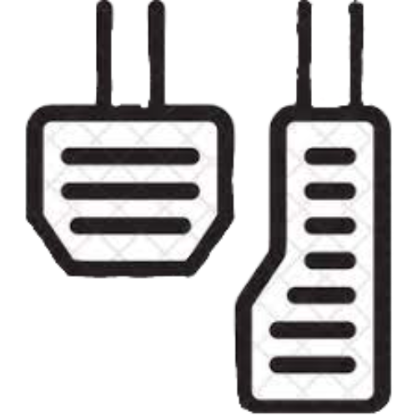
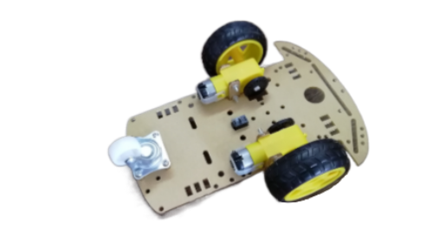


Project objective
Design a wireless control scheme that will operate a remote-controlled race car where the wireless communication is facilitated through the audible frequency bandwidth

Slide 5
Constraints
01
Wireless communication
02
Volume limit (dB)
03
Frequency limit to human hearing range (20Hz - 20KHz)
04
Make use of supplied cart

Slide 6
Assumptions
Unregulated noise operating environment
Performance prioritised over efficiency
Presence of electromagnetic interference
No long-range communication

Slide 7
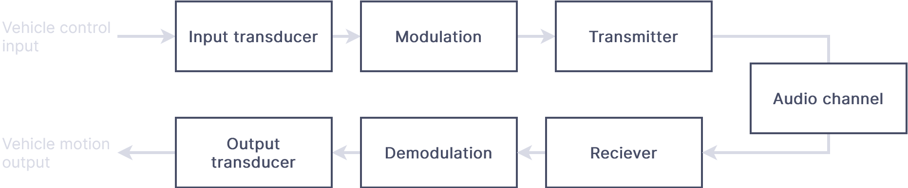
System level analysis
Transmitter
Receiver

Slide 8
Design consideration
There are three main areas of focus
Controller
Communication System
Vehicle Drive System
Analogue or Digital Controller
How to encode the data into the signal
How many possible states can the vehicle be in
How will the signal be transmitted
How is steering going to be achieved
How is the speed of the vehicle going to be controlled
How the motors will be driven
Analogue or Digital communication
What modulation scheme

Slide 9
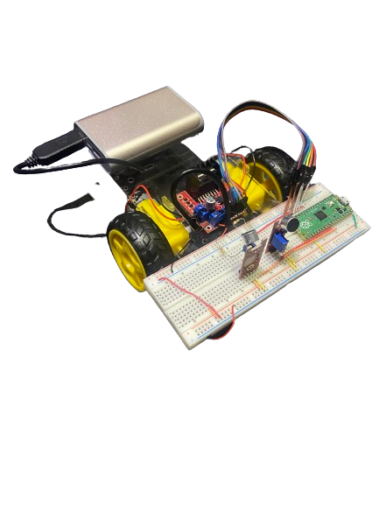
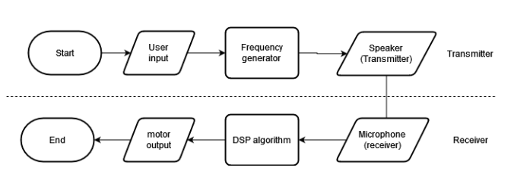
Broad Overview of Implementation
Constructed Cart
System diagram of the cart

Slide 10
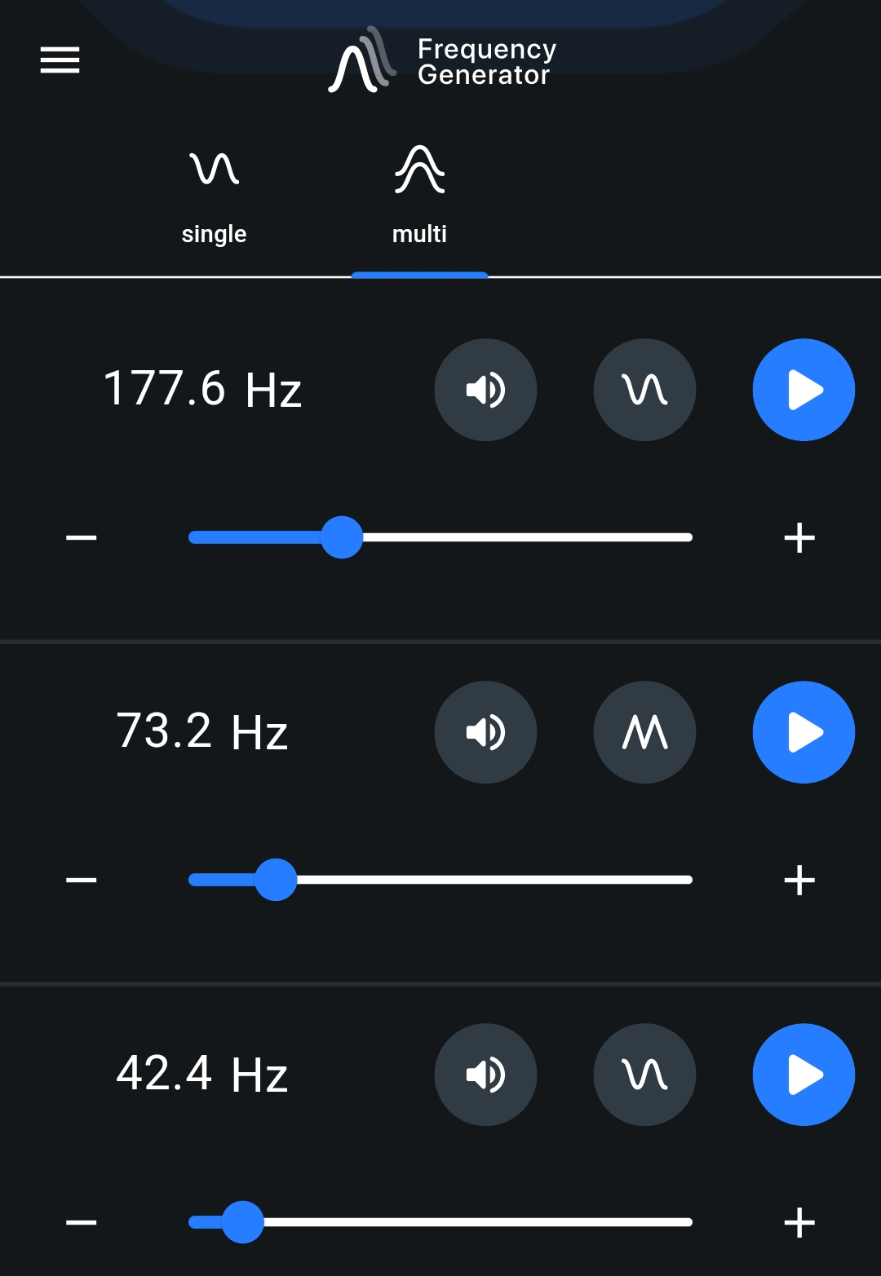

Controller
Tone Generator App
The frequency generation and modulation was
carried out though a tone generator app
Using a tone generator app, we were able to:
Save on development time as we don’t need to develop an analogue circuit for frequency generation and modulation
Allow us for rapid prototyping and testing other frequency ranges which would not have been possible with an analogue circuit
The modulation of the carrier and message signal is built into the app
The controller can output 4 possible states:
1) Remain stationary 2) Power Both Motors
3) Power Left Motor 4) Power Right Motor
Choosing for the system to only have 4 possible states allows one to
minimize the amount of data and frequencies needed to control the
Cart. We use 4 frequencies to represent each state.

Slide 11
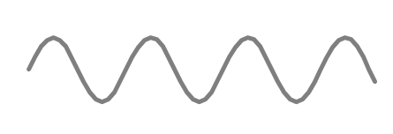
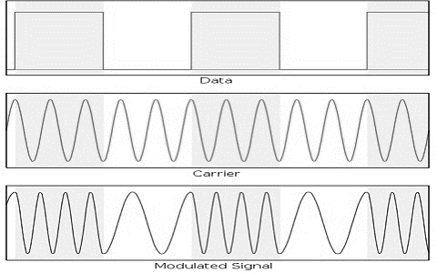
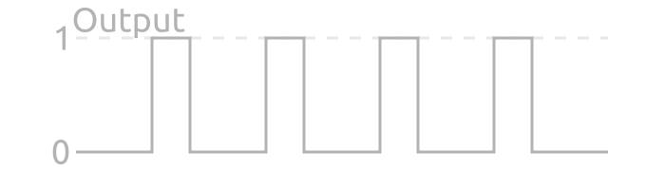

Controller
Data encoding using PWM
Message signal
Modulation
PWM signal
Carrier signal
Using a PWM signal to encode data benefits as no additional processing is required after demodulation when compared to binary encoding
Sound Transmission
Bluetooth speaker
Design Iterations of the Controller
Microcontroller Binary Encoding
Microcontroller PWM Encoding
Tone Generator PWM Encoding

Slide 12
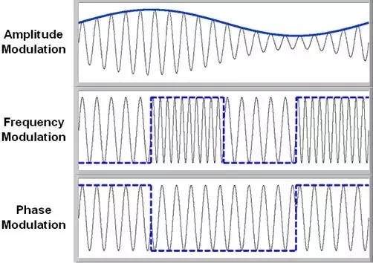
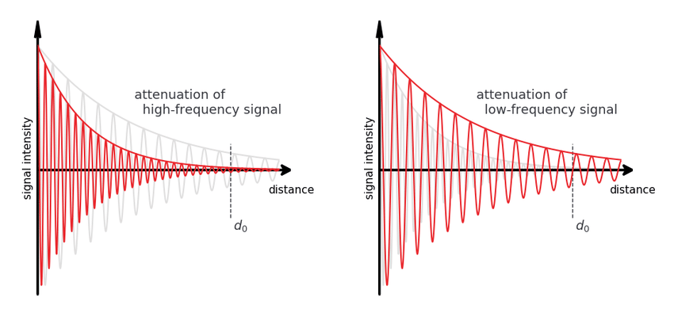
Communication System
Frequency Modulation over Amplitude Modulation
Noise resilience (SNR)
Resilience to obstructing bodies
Less signal attenuation at distances
Easily implementable with a PWM signal
Frequency Bandwidth
An operating frequency bandwidth of 1KHz to 5KHz was chosen to avoid noisy parts of the spectrum measured in the test environment
Moreover, limiting the signal to lower part of the audible spectrum allows the signal to maximise distance while minimising signal attenuation
Modulation Scheme
The signal was modulated through Frequency Shift Key (FSK) as it has:
High SNR
Reduced implementation complexity
BFSK
PWM FSK

Slide 13
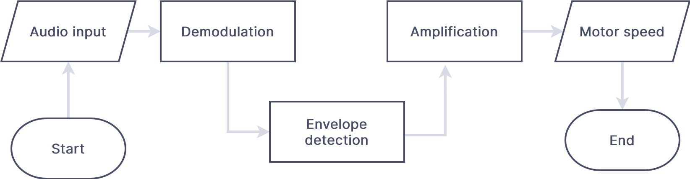
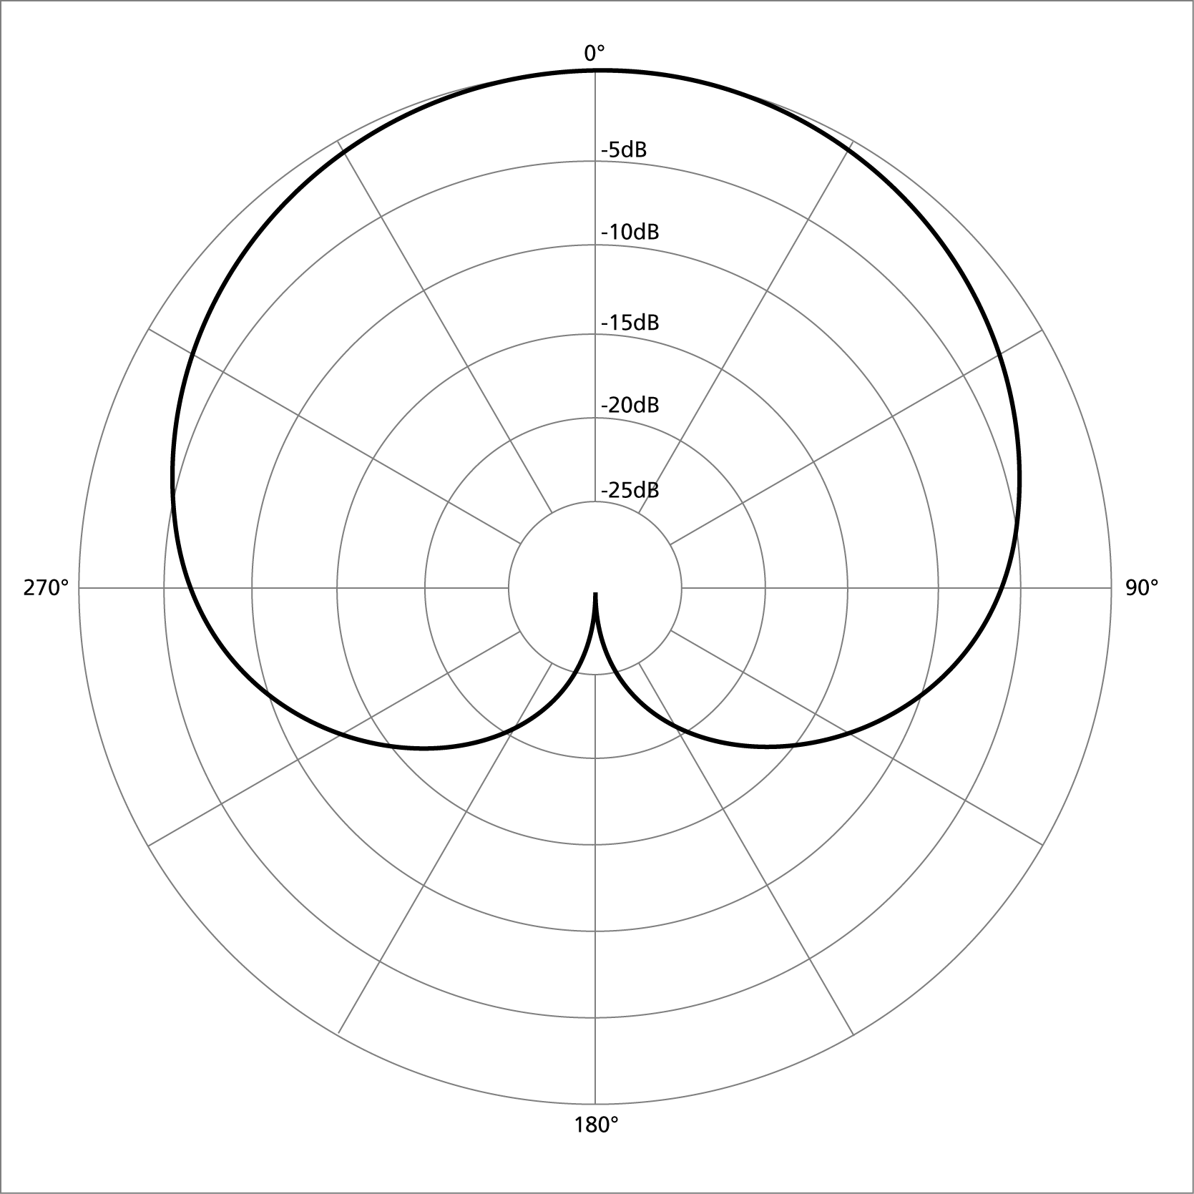
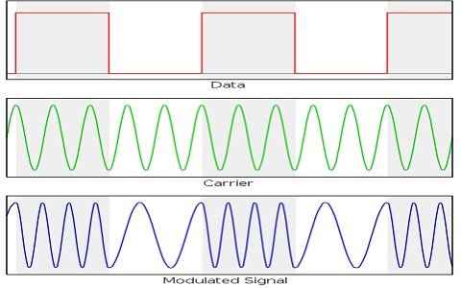
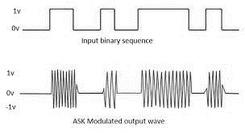

Receiver
The receiver is comprised of 3 main components:
Phased microphone array
Microcontroller
Motor driver circuit
Receiver Block Diagram
Single microphone
Phased microphone array
Microphone Design
The audio input was changed from a single to phased array microphone setup due to the cardioid pattern of signal attenuation at varying angles as the cart will undergo rotation changing the angle of incidence.
Demodulation
Envelope detection
Voltage output

Slide 14
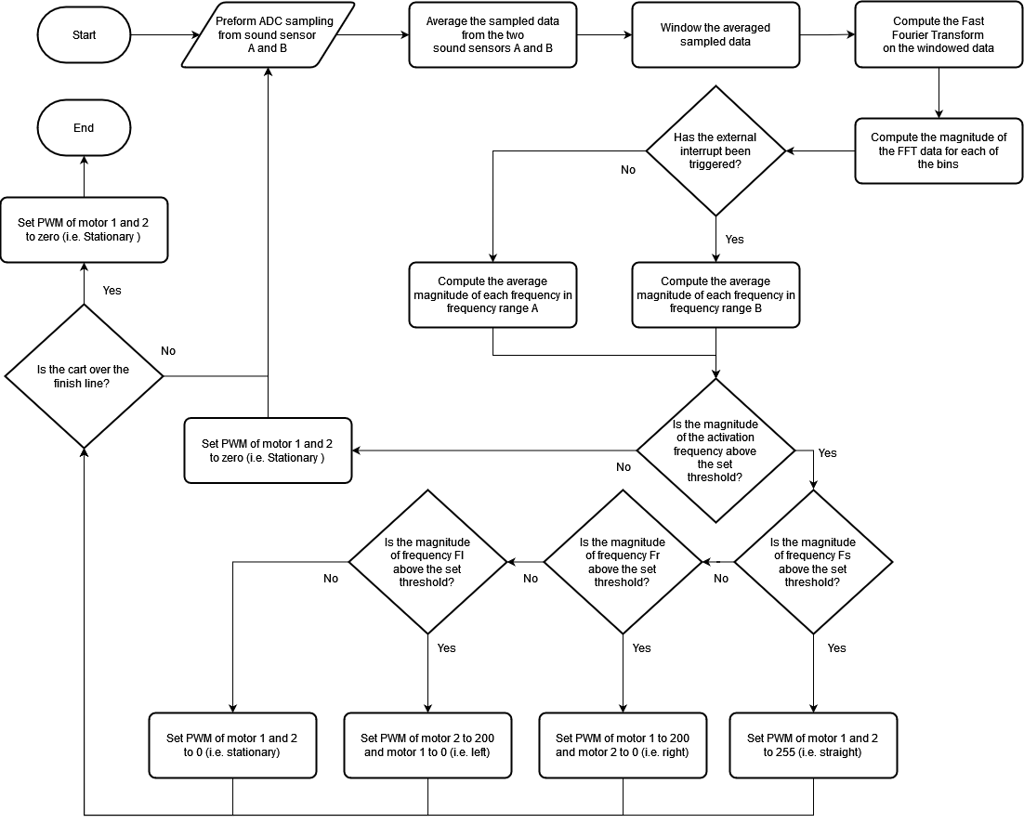
Demodulation
Demodulation Algorithm Flowchart
The Raspberry Pi Pico was used for demodulation as the higher clock frequency allows for greater sampling frequency and response time of the cart
Demodulation was carried out using:
Fast Fourier Transform algorithm
Samples
Hamming windowing function
Design Iterations of the Filter
Analogue filter circuit
Microprocessor DSP

Slide 15
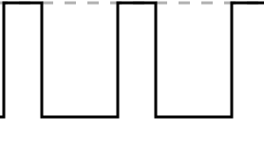

Motor and steering control
How will the motors speed be controlled ?
Pulse width modulation using a microcontroller and H-bridge motor controller
Advantage :
Simple to implement
Fast response
Reliable
Disadvantage :
Costly
Back EMF induces large negative current
Left
Motor
How will steering be controlled ?
Varying the voltage differential of the left and right motor
Microcontroller
Right
Motor
Advantage :
High steering resolution
Disadvantage :
Requires 2 channels

Slide 16
Critical Analysis
Controller
Receiver
The controller successfully performed its task of taking in user input, producing a modulated signal and transmitting it as an audio wave.
This was achieved while maintaining a fast responsive system that is dynamic in its operating ranges and easily accessible.
However, some aspects could be improved on:
Multiple frequencies are inefficiently used to transmit data
The user interface is not intuitive
The receiver successfully performed its task of taking in a signal, filtering any noise and driving the motor according to the given input. The system has a fast response time and has a wide operating range of frequencies
Some critical points to note :
Spectral leakage form windowing function
Noise filtering at greater distances
Limited steering
Asymmetric performance of left and right motors
H-Bridge low power efficacy

Slide 17
Recommendations
Reducing the number of frequencies used to 3
Desing a user interface for the app
Use a faster switching motor driver circuit
Use a Nuttal Window for the FFT
Create a frequency allocation to avoid interference
Implement BFSK with bit error correction
Make use of Dual tone multi-frequency
Ultrasonic transmitter

Slide 18

Thank you!
ANY QUESTIONS

